Slide 1
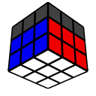
Improver Method – Pt. 2
Michael George
WCA ID: 2015GEOR02

Slide 2
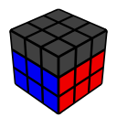
First 2 Layers (F2L)
“Beginner” method used 2 simple triggers
Left-handed trigger - U’ L’ U L
Right-handed trigger – U R U’ R’
“Improver” method will use 4 additional triggers
“Sexy Move” for alternative corner insertion – L’ U’ L U and R U R’ U’
“Sledgehammer” for alternative corner + edge pairing – L F’ L’ F and R’ F R F’
The new triggers are relatively easy to learn and incorporate into your solves
Alternative corner insertion will reduce the number of y / y’ rotations
Alternative corner + edge pairing will reduce the number of y / y’ rotations

Slide 3
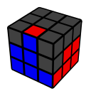
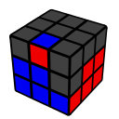
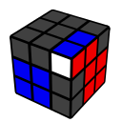
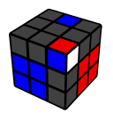
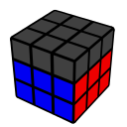
Solving the F2L
The basic approach is to “pair” a corner + edge then “insert” them into the appropriate “slot”
Step 2.1 – “Solve” the corner piece
Step 2.2 – “Setup” the corner + edge in the U-layer, ready for insertion
Step 2.3 – “Insert” the corner + edge into the appropriate “slot”

Slide 4
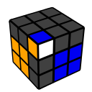
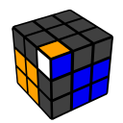
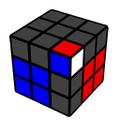
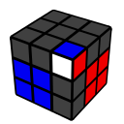
Step 2.1 – Solving the Corner
A simple trigger can be used to “solve” a corner without using a y / y’ rotation
Setup: Choose the appropriate setup + trigger based on the corner orientation
Execution: Turn the U-layer with your index finger(s)
U’ L’ U L
L’ U’ L U
R U R’ U’
U R U’ R’

Slide 5
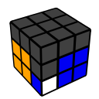
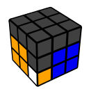
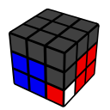
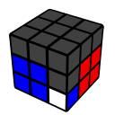
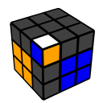
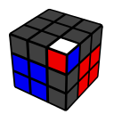
Step 2.1 – Tricky Corners
U’ L’ U L * 2
L U L’ U’ * 2
R U R’ U’ * 2
U R U’ R’ * 2
U’ L’ U L * 3
or
L U L’ U’ * 3
R U R’ U’ * 3
or
U R U’ R’ * 3

Slide 6
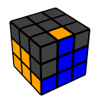
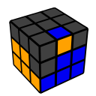
Step 2.2 – Pairing the Edge + Corner
A simple trigger can be used to “setup” an edge with its corner without using a y / y’ rotation
Setup: Choose the appropriate setup + trigger based on the edge orientation
Execution: Turn the U-layer with your index finger(s)
U’ L’ U L
U2’ L F’ L’ F
U2 R’ F R F’
U R U’ R’

Slide 7
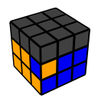
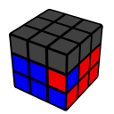
Step 2.2 – Tricky EDGES
If the edge is already in the correct slot but “badly oriented” the pair needs to be extracted and re-solved
“Extract” the corner and edge pieces using the “Sledgehammer” – L F’ L’ F or R’ F R F’
“Solve” the corner using the “Sexy Move” – i.e. step 2.1
“Setup” the corner and edge using the “Sledgehammer” – i.e. step 2.2
(L F’ L’ F) (L’ U’ L U) U2 (L F’ L’ F)
(R’ F R F’) (R U R’ U’) U2 (R’ F R F’)

Slide 8
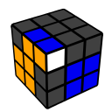
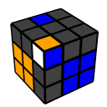
Step 2.3 – Inserting the F2L Pair
Insert the F2L pair as you would solve a corner in step 2.1 without using a y / y’ rotation
Setup: Choose the appropriate trigger based on the corner orientation
Execution: Turn the U-layer with your index finger(s)
U’ L’ U L
L’ U’ L U
R U R’ U’
U R U’ R’

Slide 9
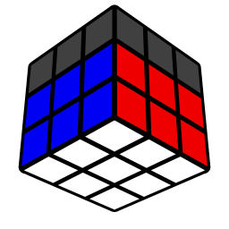

Solve the Remaining Pairs!

